Slide 1

HEALTHCARE ANALYSIS
MIS 587 GROUP 6

Slide 2





OUR TEAM
Soumya Shah
Sachin H.B
Parth Bhambure
Bitan Mani
Alexia Salcedo
Bitan Mani
2

Slide 3




AGENDA
Warehouse Design /
Dimension Modeling
Data Exploration /
Analysis
Business Implications
Background and
Dataset Description
Data Preparation /
ETL
Bitan Mani
3

Slide 4

BACKGROUND
BUSINESS PROBLEMS
Enhanced Knowledge of Patient Profiles
Hospital Utilization Efficiency
Optimized Revenue & Billing Process
Medical Condition Insight
Insurance Coverage Optimization
Bitan Mani
4

Slide 5
DATA WAREHOUSE DESIGN

Slide 6
DATASET DESCRIPTION
DATA GRAIN
FACTS
DIMENSIONS
One row per patient in the dataset will represent a unique patient encounter, capturing relevant information such as patient demographics, medical conditions, treatments, and outcomes for that encounter.
Hospital Encounter
HospitalEncounterID (PK)
PatientID (FK)
HospitalID (FK)
InsuranceProviderID (FK)
MedicationResult
LengthOfStay
BillingAmount
AmountPaid
AmountOwed
Patient
Hospital
Insurance Provider
Alexia Salcedo
6

Slide 7
STAR SCHEMA
Alexia Salcedo
7

Slide 8
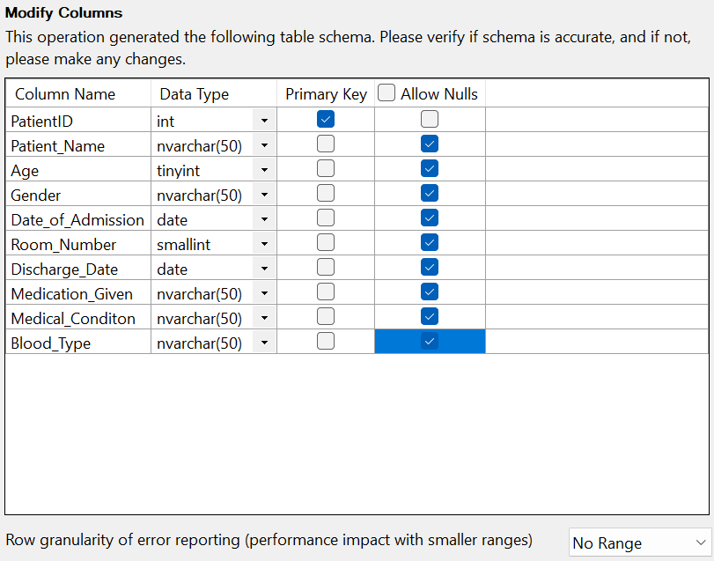
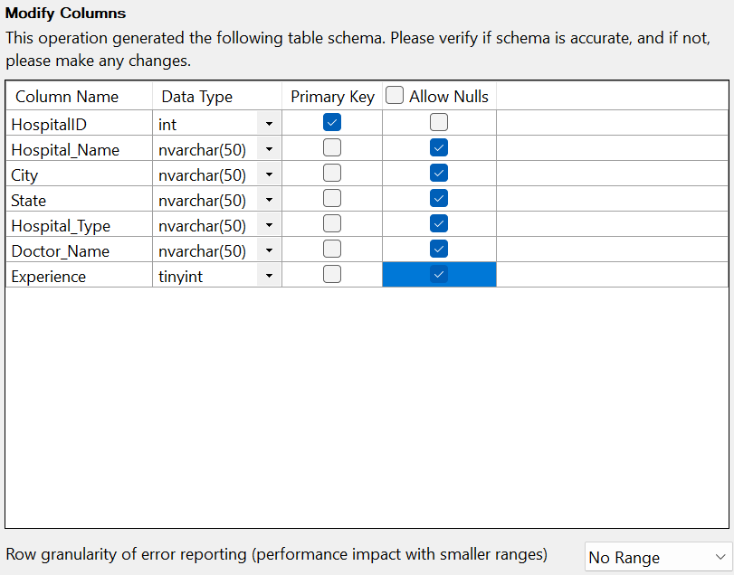
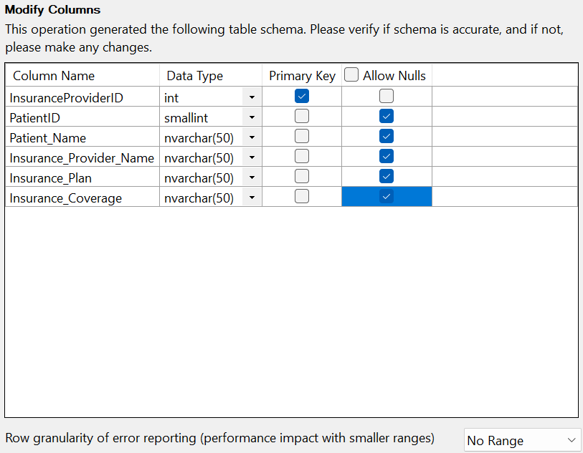
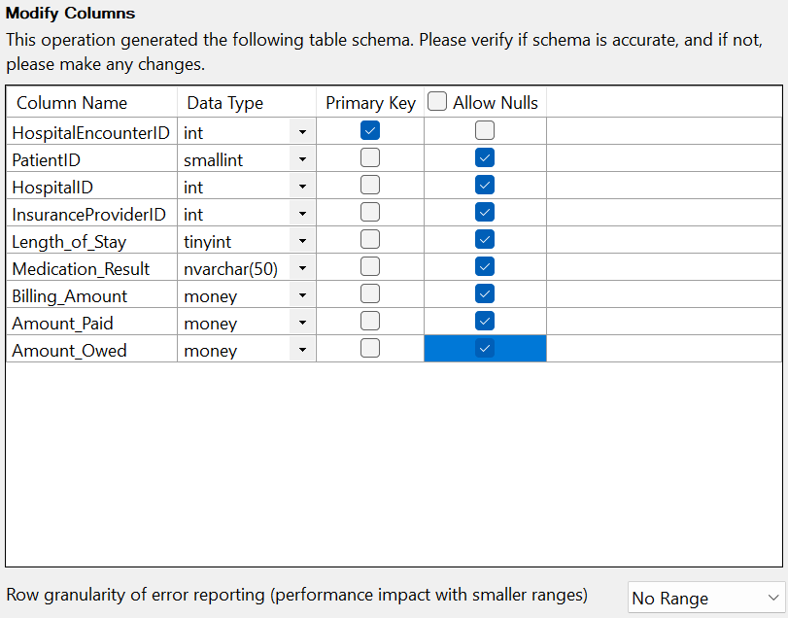
SSMS – IMPORTING FILES
Alexia Salcedo
8

Slide 9
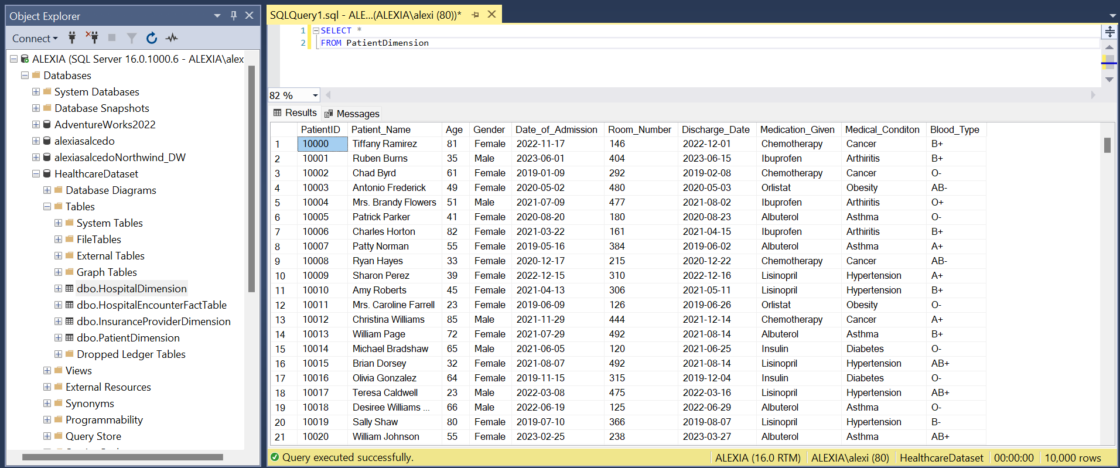
PATIENT DIMENSION
Alexia Salcedo
9

Slide 10
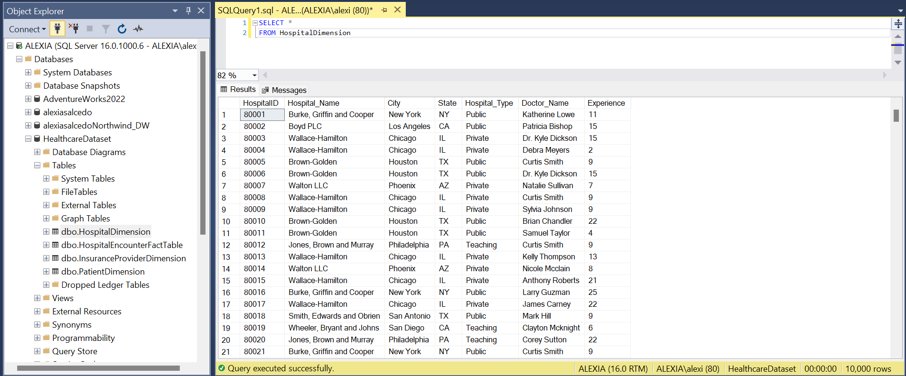
HOSPITAL DIMENSION
Alexia Salcedo
10

Slide 11
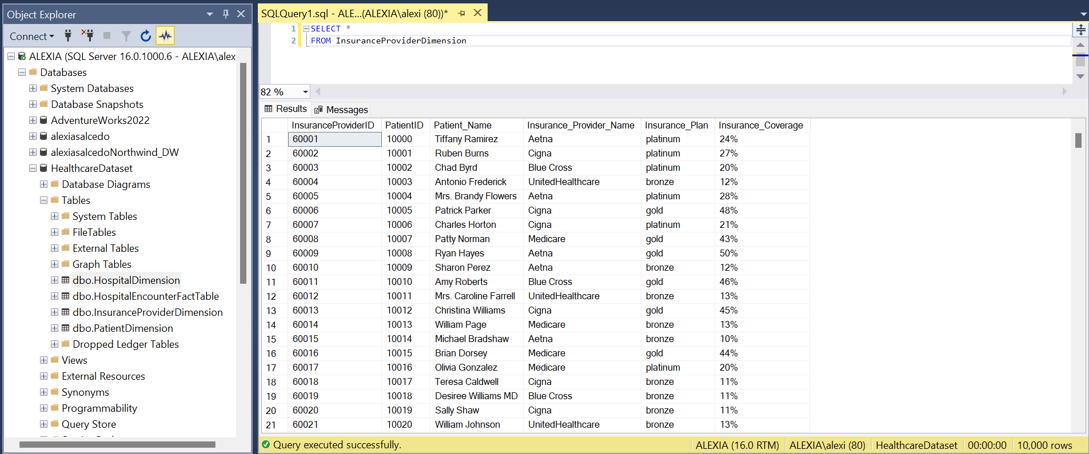
INSURANCE PROVIDER DIMENSION
Alexia Salcedo
11

Slide 12
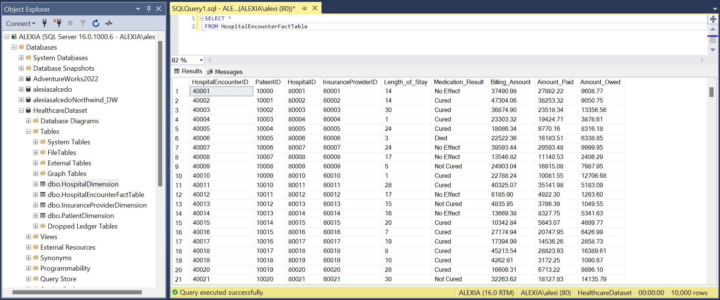
Hospital Encounter Fact Table
Alexia Salcedo
12

Slide 13
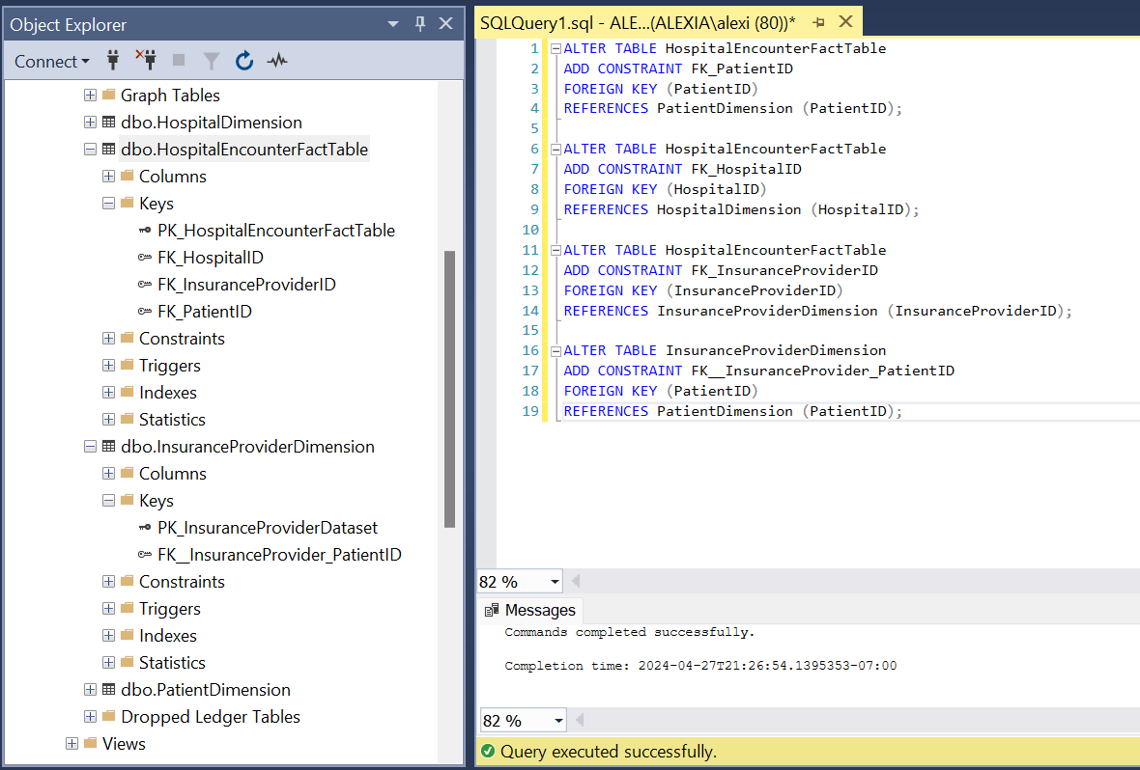
FOREIGN KEYS
Alexia Salcedo
13

Slide 14
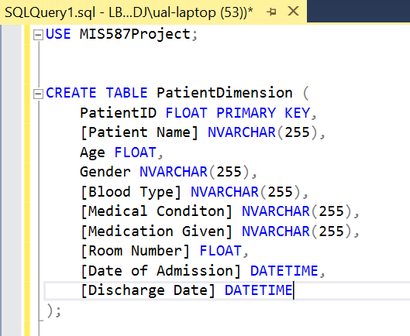
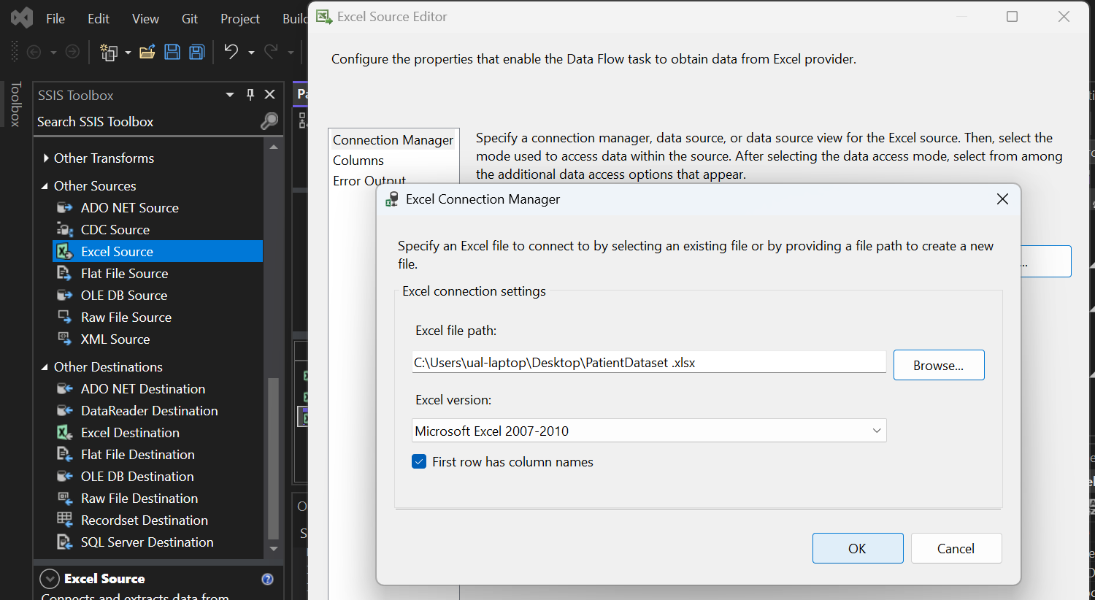
DATA WAREHOUSE IMPLEMENTATION
Parth Bhambure
14

Slide 15
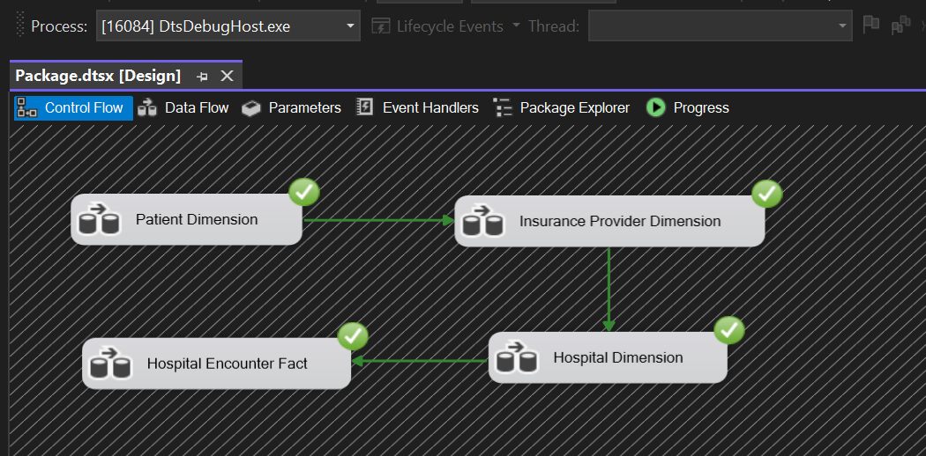
ETL CONTROL FLOW (SSIS)
Source: Excel File
Destination: Data Warehouse (SQL Server)
Parth Bhambure
15

Slide 16
Exploratory Data Analysis
Descriptive Statistics
Data Preprocessing
Data Transformation
Visual Exploration
Parth Bhambure

Slide 17
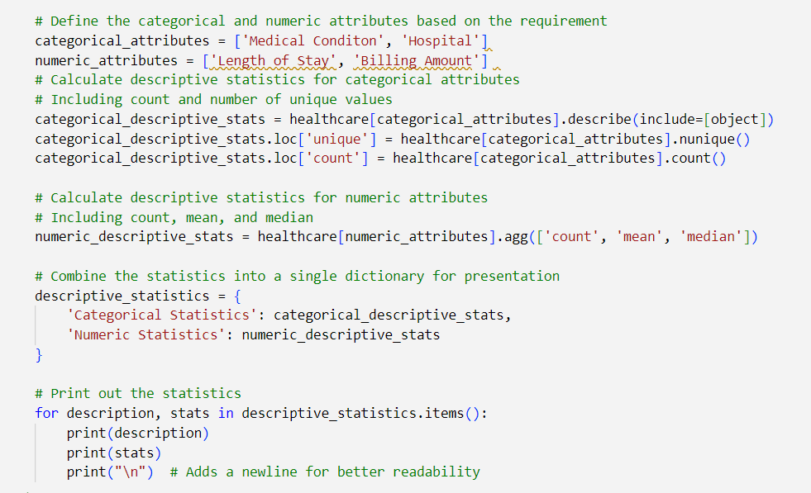
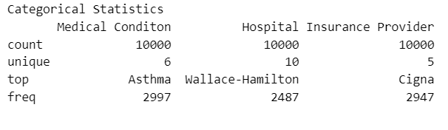
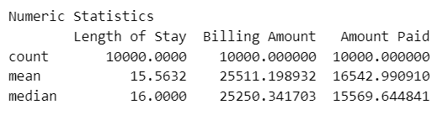
Descriptive Statistics
Parth Bhambure
17

Slide 18
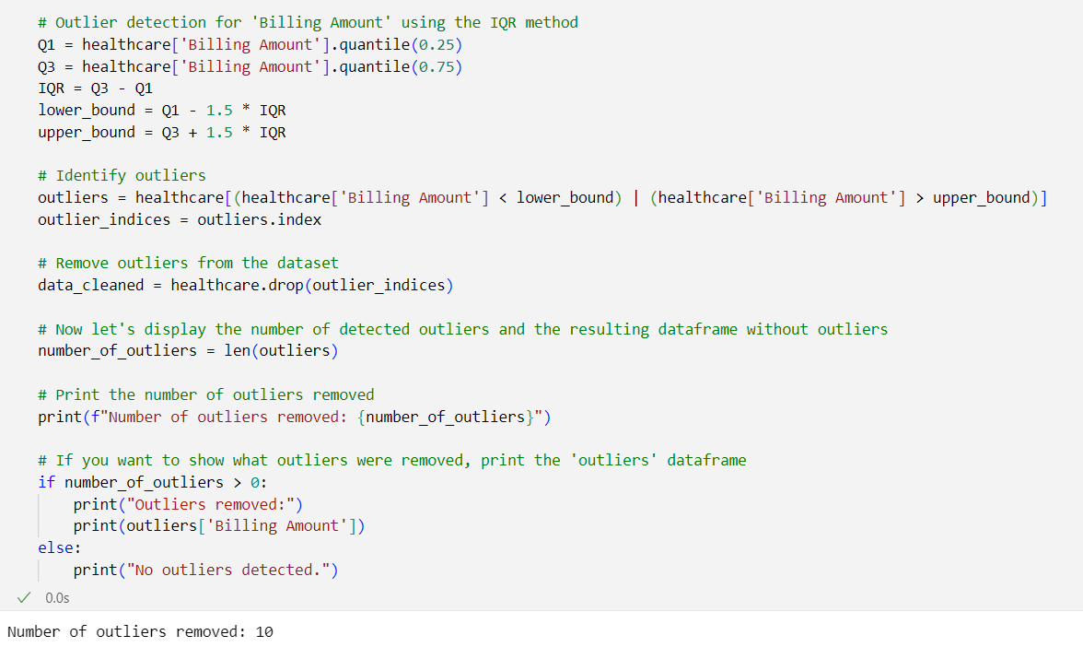
Data Preprocessing
Outlier Detection
Parth Bhambure
18

Slide 19
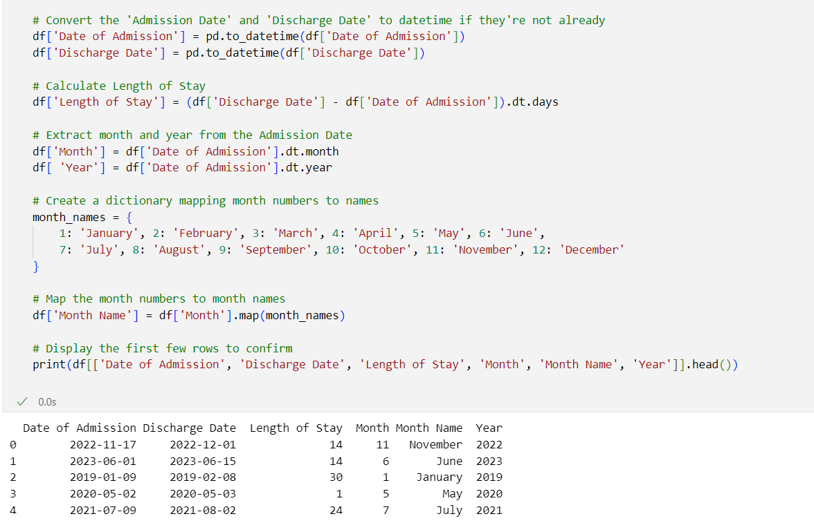
Data Transformation
Derived Columns
Parth Bhambure
19

Slide 20
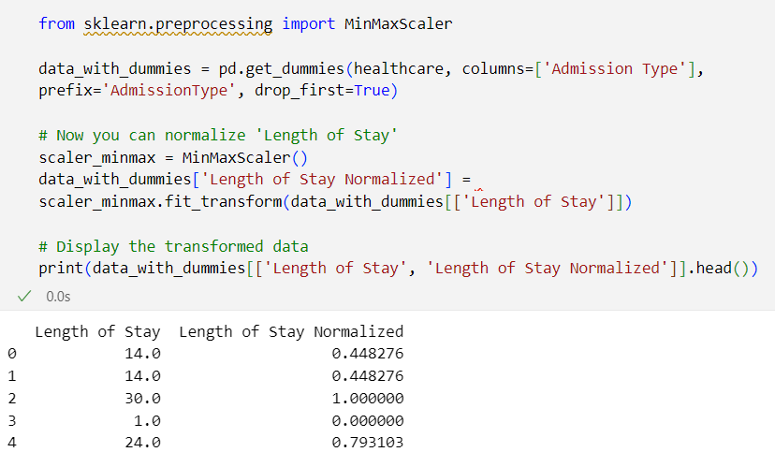
Data Transformation
Normalization of Length of Stay
Parth Bhambure
20

Slide 21
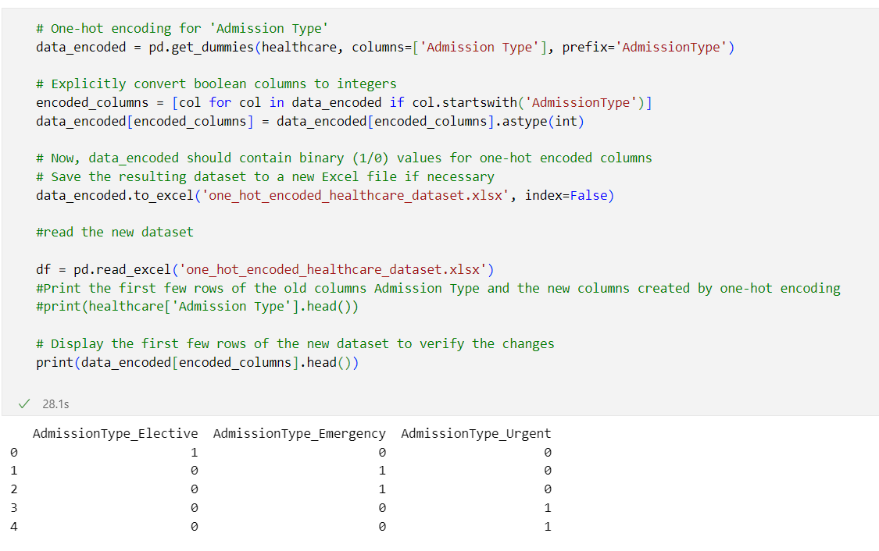
Data Transformation
One-hot Encoding for Admission Type
Parth Bhambure
21

Slide 22
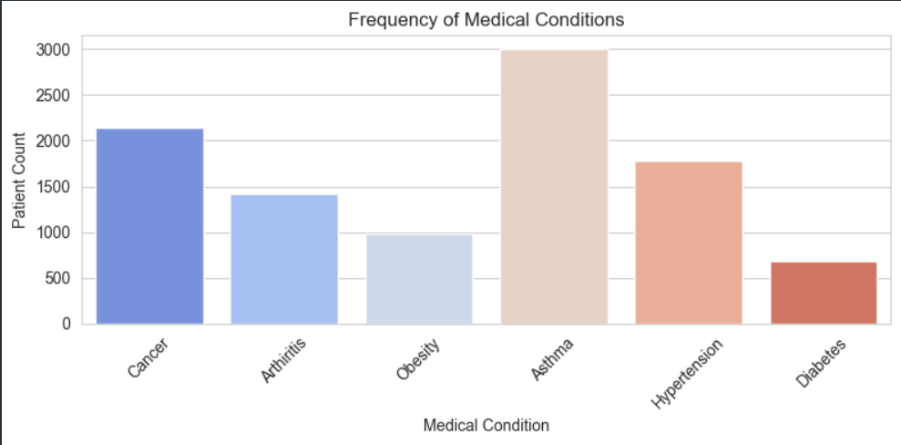
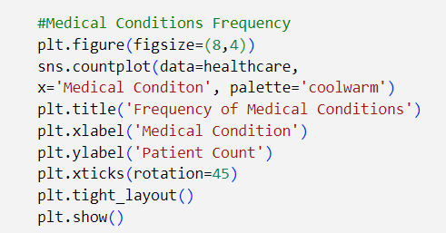
Visual Exploration
Sachin
22

Slide 23
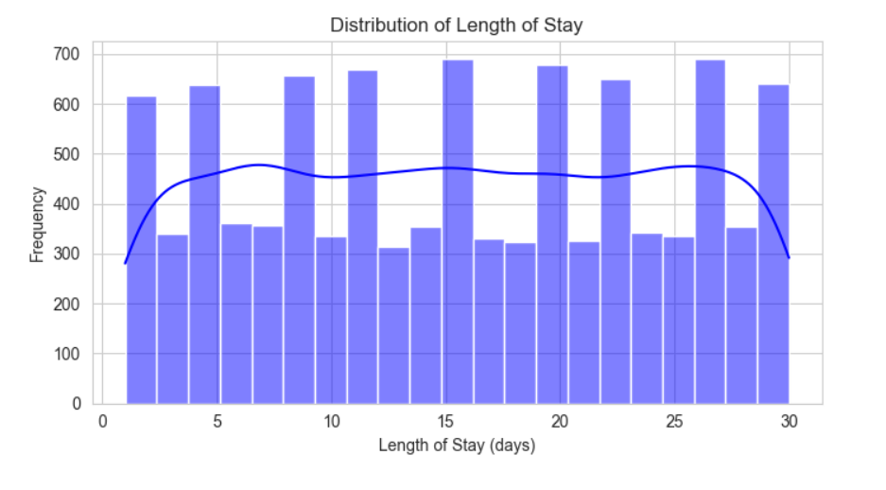
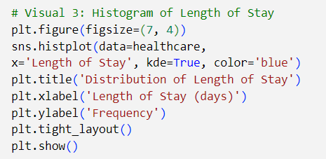
Visual Exploration
Sachin
23

Slide 24
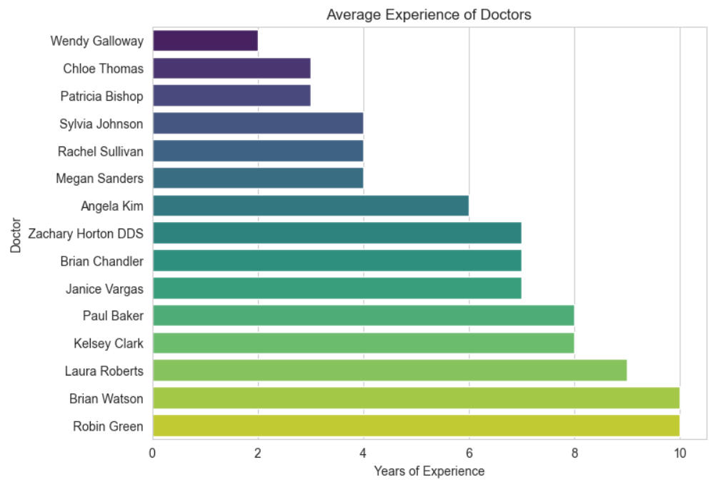
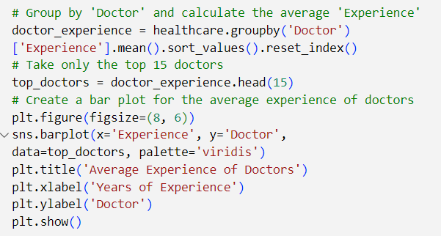
Visual Exploration
Sachin
24

Slide 25

DATA ANALYSIS AND VISUALIZATIONS
Soumya Shah

Slide 26
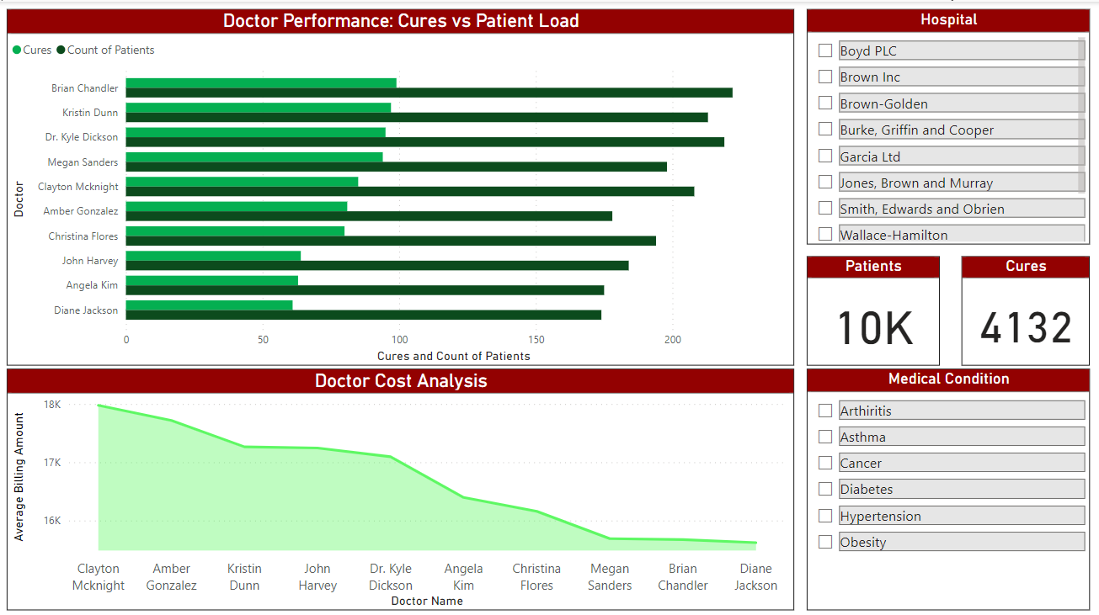

Data Analysis & Visualizations
Identification of top-performing doctors by analyzing recovery ratios
Analytical view into Cost of treatment per doctor
26
Soumya Shah
Notes:
Here are the two points, phrased effectively for presentation:
Optimizing Patient Outcomes: The dashboard enables identification of top-performing doctors by analyzing recovery ratios, which measures successful patient outcomes against total cases treated. This insight is pivotal for recognizing and replicating effective treatment approaches across the healthcare system.
Financial Efficiency in Patient Care: It provides an analytical view into the cost-efficiency of care per physician, revealing the economic impact of treatment methods. This helps in strategizing cost-effective healthcare while maintaining high-quality patient care standards.

Slide 27
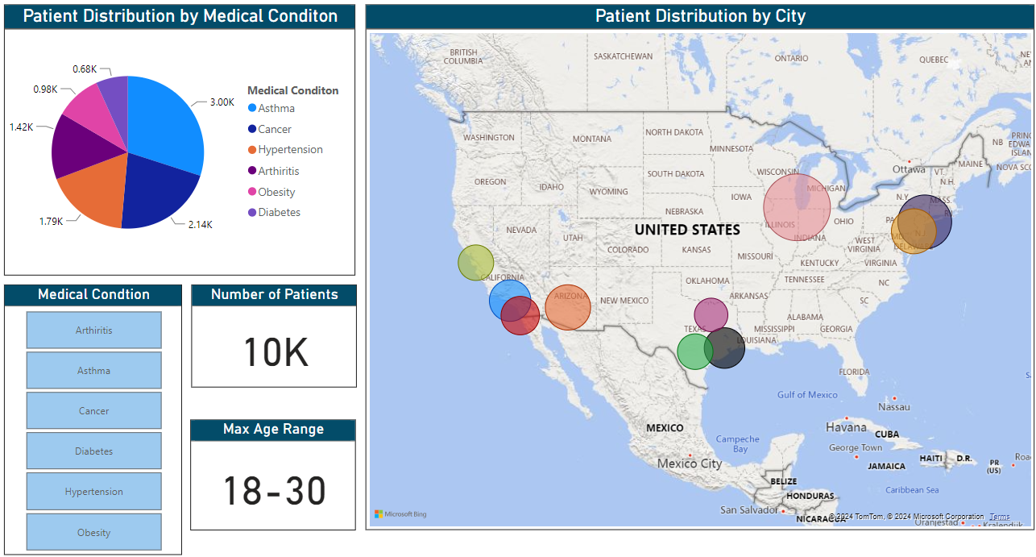
Data Analysis & Visualizations
Displaying patient load per city
Visual breakdown of patient distribution by medical condition
Identifying the maximum age range for patients per city and medical condition
Soumya Shah
27
Notes:
From this dashboard, we can articulate the following points:
Prevalence of Conditions: The pie chart offers a visual breakdown of patient distribution by medical condition, which can highlight the most prevalent health issues within the patient population. This information is crucial for healthcare providers to allocate resources and plan preventative care initiatives effectively.
Geographic Health Trends: The map illustrates patient distribution across different cities and hospitals, providing insight into regional health trends and the potential need for specialized services in certain areas. It also indicates the patient load on hospitals in various locations, which can inform resource distribution and staffing requirements.
Demographic Focus: By presenting the maximum age range for patients, the dashboard allows for a demographic analysis of the patient base, which can be used to tailor healthcare programs and outreach to specific age groups that are most affected by particular medical conditions.

Slide 28
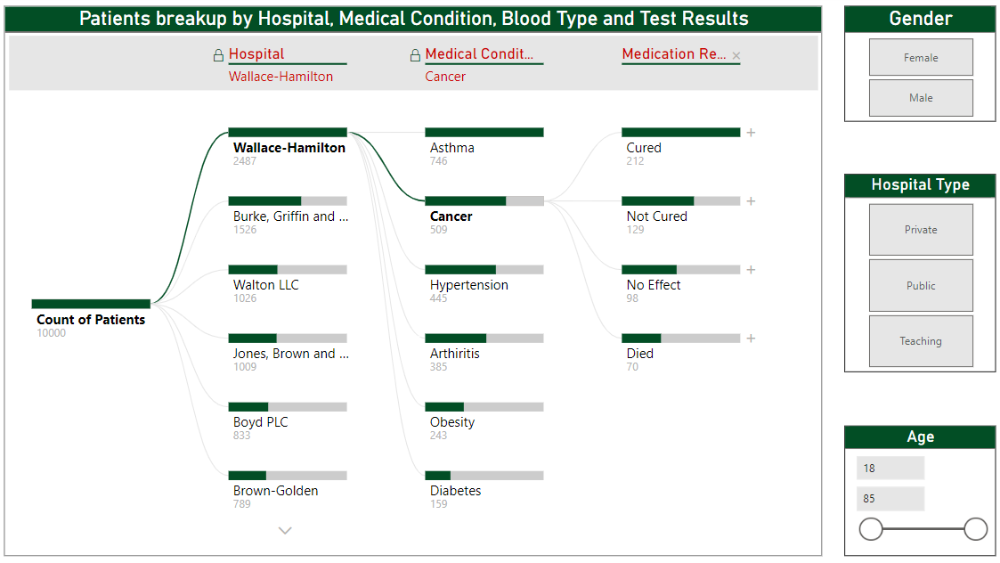
Data Analysis & Visualizations
Aggregating critical data points providing a comprehensive profile of patient demographics and medical history.
Soumya Shah
28
Notes:
For the dashboard displayed, focusing on patient demographics, medical conditions, and outcomes by hospital, here are three concise points:
Integrated Patient Profiles: The dashboard aggregates critical data points such as medical condition prevalence, blood types, and treatment outcomes, segmented by hospital, providing a comprehensive profile of patient demographics and medical history.
Outcome-Driven Resource Allocation: With visual filters for medical conditions and corresponding treatment results, the dashboard enables healthcare administrators to identify trends in treatment effectiveness and potential areas for resource reallocation or further medical training.
Targeted Treatment Strategies: Leveraging detailed breakdowns by blood type and gender, the dashboard empowers medical staff to develop targeted treatment strategies, enhancing personalized care and potentially improving patient outcomes.

Slide 29
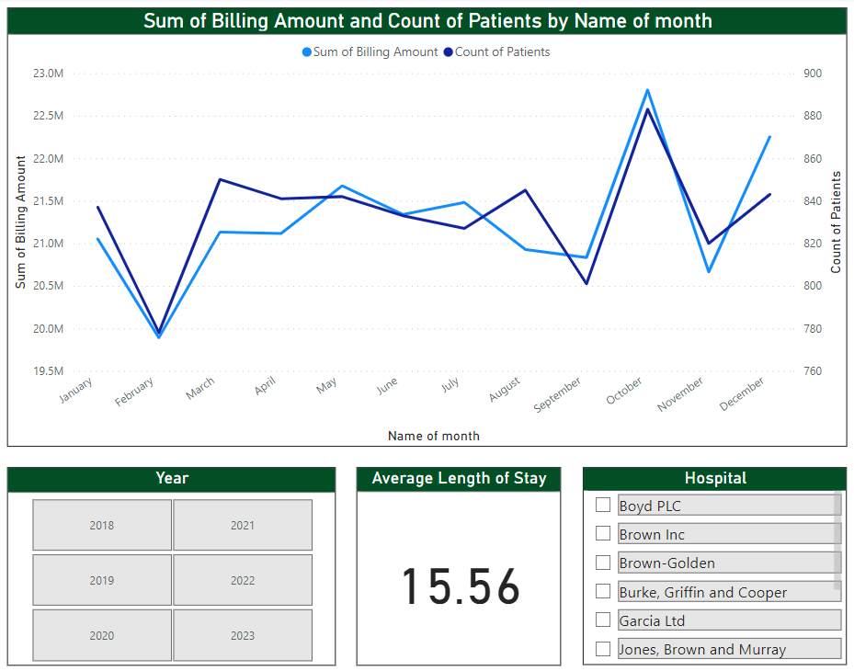
Data Analysis & Visualizations
Relationship between billing amounts and patient volumes over time
Highlights potential periods of high and low hospital utilization
Soumya Shah
29
Notes:
Based on the dashboard shown, here are three insights that could be drawn:
Billing and Volume Correlation: The line graph demonstrates the relationship between billing amounts and patient volumes over time, offering insights into operational trends, such as whether increased patient numbers correspond to increased billing.
Utilization Trends: By viewing patient count alongside billing data across months, the dashboard highlights potential periods of high and low hospital utilization, which can inform staffing and resource planning.
Efficiency Metrics: The "Average Length of Stay" metric provides a snapshot of hospital efficiency. A lower number might indicate effective patient throughput and resource utilization, while a higher number could suggest areas for process improvement.

Slide 30
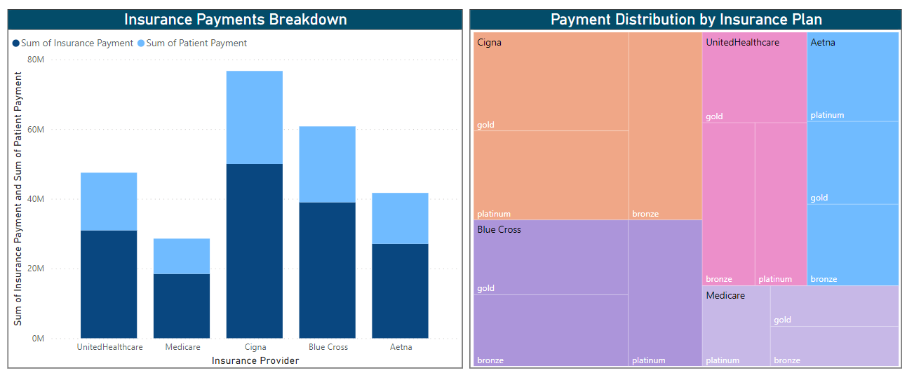
Data Analysis & Visualizations
Illustrates the comparative financial contributions made by patients and their insurance providers
Offers insights into which plans contribute most within the insurance provider
Soumya Shah
30
Notes:
Based on the visualizations in this dashboard, here are three succinct insights:
Payment Contributions: The bar chart illustrates the comparative financial contributions made by patients and their insurance providers, showcasing which entities bear the greater cost burden.
Insurance Plan Comparison: The treemap highlights the distribution of payments across different insurance plans within each provider, offering insights into which plans contribute most to the revenue and may hint at the popularity or coverage levels of different plans.
Provider Payment Patterns: The combined analysis of both visuals could inform strategies for negotiating with insurance providers, based on their payment patterns and the distribution across various insurance plans.

Slide 31

PREDICTIVE MODELLING
Sachin H B

Slide 32
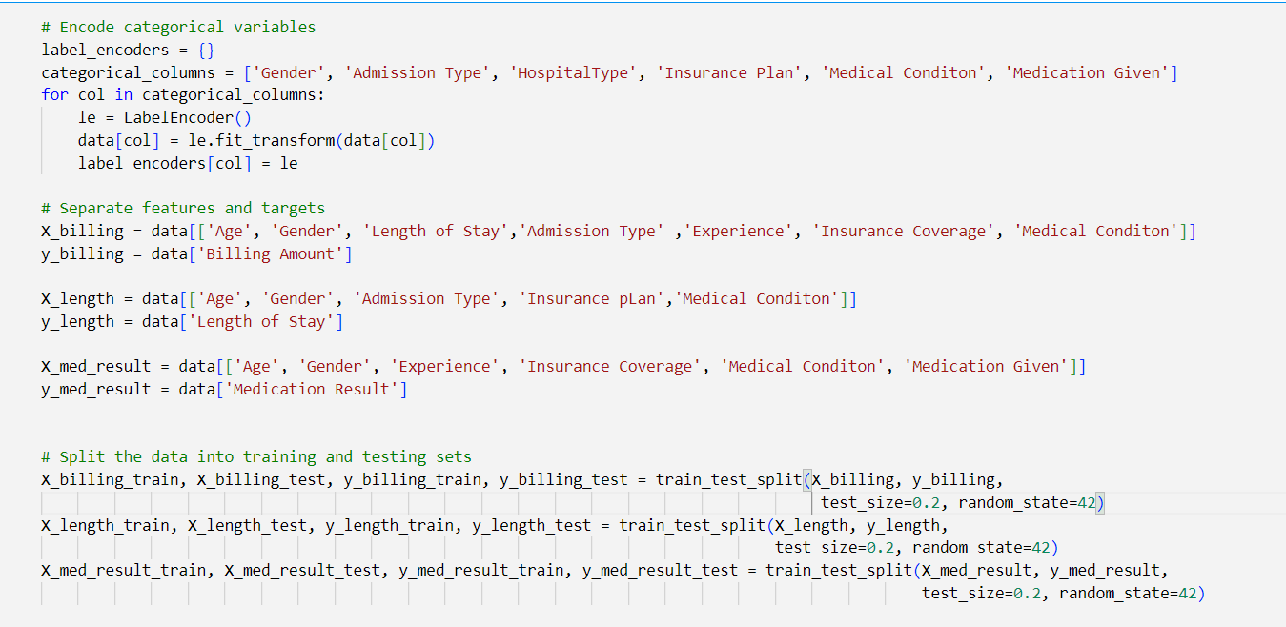
Predictive Modelling
Predict Useful Parameters Based on the past data
Billing Amount
Length of Stay
Sachin
32

Slide 33
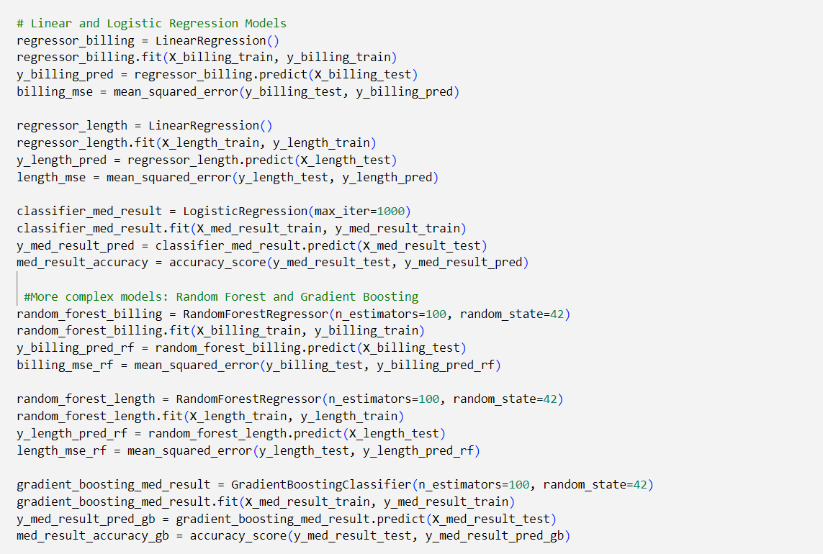
Predictive Modelling
Sachin
33

Slide 34
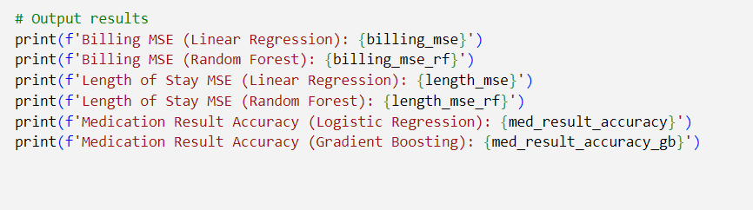
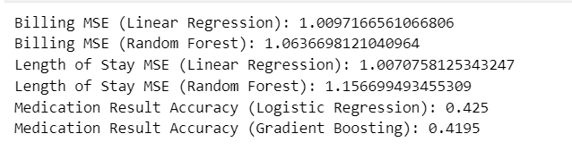
Predictive Modelling
Sachin
34

Slide 35

BUSINESS IMPLICATIONS
Bitan Mani

Slide 36



Business Implications
City-Wise
Medical Conditions
Doctor Reputation
Estimate Expenses
Gives information to the administrators to recognize the work and optimize workloads by planning
Helps patients decide in choosing the doctor based on past success records
STAKEHOLDERS:
Healthcare Administrators
Patients
Helps patients estimate the billing expenses based on the past records
Gives the hospital management an idea of revenue generated based on medical conditions/demographics
STAKEHOLDERS:
Patients
Hospital Management
Helps identify any hotspots for medical conditions in a particular area
Might give policy makers insights to identify severe health conditions and make preventative/policy planning
Helps hospitals do infrastructure/capacity planning for a particular medical condition
STAKEHOLDERS:
Clinicians and Healthcare Providers
Government agencies and policymakers
36
Bitan Mani

Slide 37



Business Implications
Relationship b/w Medical Attributes
Resource
Planning
Insurance Provider Analysis
Can give insights into any relations between age/gender/blood type with medical conditions and help patients be better prepared in preventative care
Might help doctors in identifying any trends that can be used to educate the patients
STAKEHOLDERS:
Patients
Doctors/Medical Staffs
Patient volume trends over time can give multiple insights
Any seasonal variation might help in financial planning for the insurance providers, resource planning for the hospital management etc.
STAKEHOLDERS:
Insurance Providers
Operations Managers
Gives insights to the insurance providers on the expenses incurred in different locations/medical conditions
This could prove useful to develop healthcare plans
STAKEHOLDERS:
Insurance Providers
Patients
37
Bitan Mani

Slide 38

THANK YOU

